Slide 1
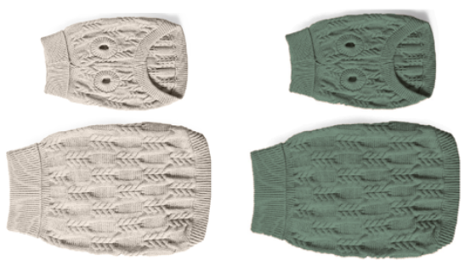
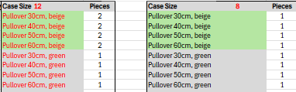
HV-33215_CLOTHES_PULLOVER, COZY
SPECIFICATIONS: | VariantS (pictures):
Variants: Pullover 30cm, beige Pullover 40cm, beige Pullover 50cm, beige Pullover 60cm, beige Pullover 30cm, green Pullover 40cm, green Pullover 50cm, green Pullover 60cm, green Item description: Cuddly soft dog pullover in classic cable knit pattern * Mashine washable up to 30ºC degrees Dimension: Pullover: 30cm (50g), 40cm (80g), 50cm (110g), 60cm (140g) Material: With warm acrylic knit fabric, acrylic sales packaging: hangtag

